Slide 1




CERVISHIELD Empowering Precision, Ensuring Health
X
. . .
TEAM: INITIATORS
Anjali Singh
Ayushi Agarwal
Jhanvi Gupta

Slide 2
PROBLEM STATEMENT
Despite advancements in healthcare, cervical cancer continues to pose a significant global health challenge. Limited access to regular screenings, insufficient awareness about preventive measures, and disparities in healthcare resources contribute to delayed diagnoses and higher mortality rates. For this "CerviShield" , helps in effortless diagnosis of Cervical cancer using Artificial Intelligence and Machine learning.

Slide 3
INTRODUCTION
Cervical cancer is a major health concern worldwide, but it can be effectively treated if detected early. This project aims to develop an AI-based tool for the early detection of cervical cancer by integrating various screening methods, including Pap smear, HPV testing, VIA, and colposcopy, into a single, comprehensive solution.

Slide 4
PROPOSED APPROACH
Our AI-based tool for the early detection of cervical cancer integrates multiple screening methods, including image analysis (Pap smear, VIA, colposcopy) and non-image data (HPV test results), providing healthcare providers with a comprehensive and efficient solution. The user-friendly interface allows easy data input and result visualization, enhancing the early detection and treatment of cervical cancer.

Slide 5
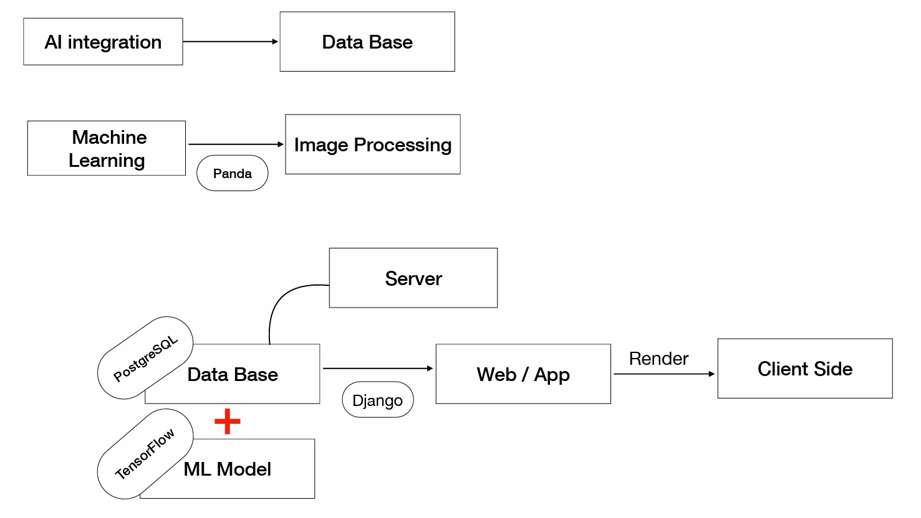
PRODUCT ARCHITECTURE

Slide 6
Why should one chose your solution?
Helps detect cancer at early stages
Analyse the proper reason for disease
Limitation
Our model with the help of AI uses non image dataset to detect cancer at early stages. It can be enhanced by using image data sets.
Deep learning can be used to analyse the actual data collected from the hospital as it will increase the accuracy for detecting the patients suffering from cervical cancer.

Slide 7
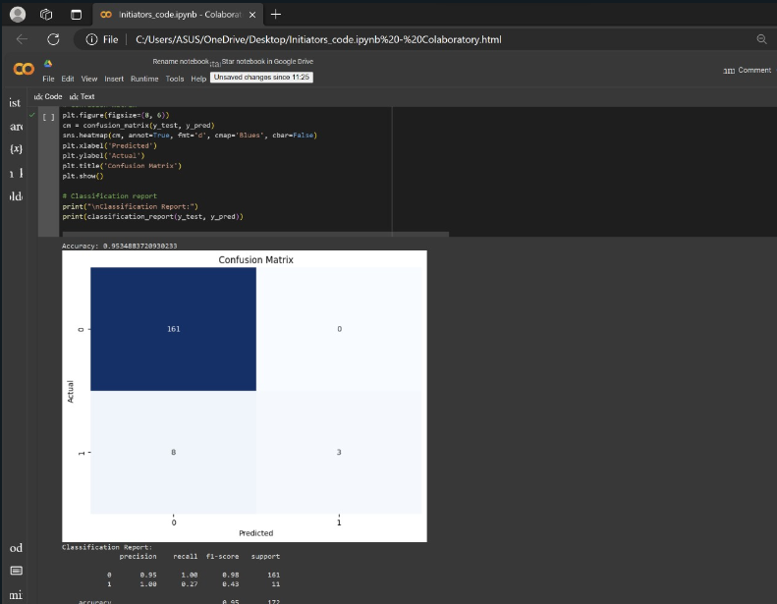
SCREENSHOT

Slide 8

TECH STACK
Python
TensorFlow
Panda
Django
PostgreSQL
Docker

Slide 9
TARGET AUDIENCE
Cervical cancer awareness targets a wide range of people, such as women, men, healthcare providers, policymakers, educators, and community leaders. The aim is to involve this varied audience in promoting prevention, early detection, and improved access to healthcare services for those at risk.

Slide 10
THANK YOU!

